Slide 1

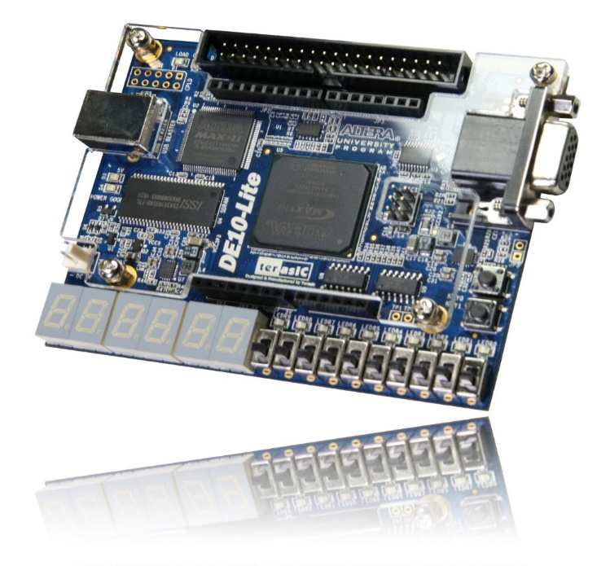
區塊圖形編輯設計

Slide 2
基本概念複習

Slide 3
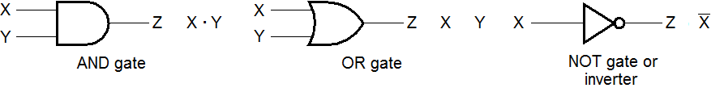
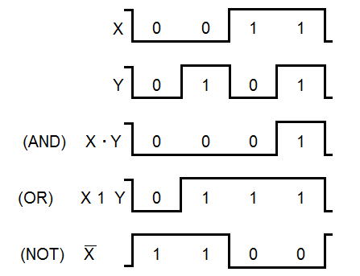
Logic Gate Symbols and Behavior
Logic gates symbols:
Timing diagram(waveform)

Slide 4
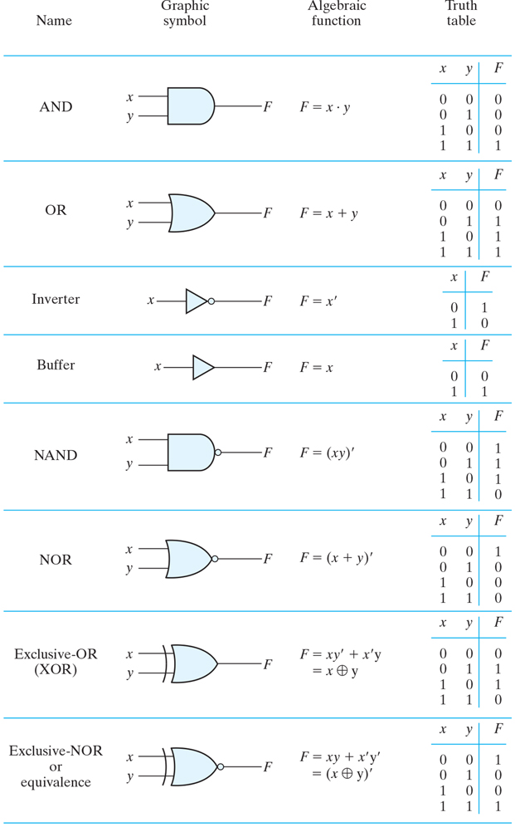
Logic Gates

Slide 5
Expressions of Logic Function
Truth Table
Equation
X Y Z
F
=
X
+
Y
⋅
Z
0 0 0
0
F
=
X
+
Y
Z
0 0 1
1
0 1 0
0
0 1 1
0
Logic Diagram
1 0 0
1
X
1 0 1
1
1 1 0
1
Y
F
1 1 1
1
Z
Boolean equations, truth tables and logic diagrams describe the same function!
Truth tables are unique; equation and logic diagrams are not.

Slide 6
Boolean Algebra
An algebraic structure defined on a set of at least two elements, B, together with three binary operators (denoted +, · and ) that satisfies the following basic identities:
1.
X
+ 0
=
X
2.
X
. 1
=
X
3.
X
1
1
4.
X
. 0
0
+
=
=
5.
X + X
=
X
6.
X . X
=
X
7.
X + X
=
1
8.
X . X
=
0
9.
X = X
10.
X + Y
=
Y + X
11.
XY
=
YX
Commutative
12.
(X + Y)
+
Z
=
X + (Y
+
Z)
13.
(XY)
Z
=
X(Y
Z)
Associative
14.
X(Y +
Z)
=
XY
+
XZ
15.
X
+ YZ
=
(X + Y)
(X + Z)
Distributive
DeMorgan
16.
X + Y
=
X . Y
17.
X . Y
=
X + Y
’
s

Slide 7
K-Map
CD
00
01
11
10
AB
0
1
3
2
00
1
1
1
4
5
7
6
01
1
1
1
12
13
15
14
11
1
1
1
10
1
8
1
9
11
10
F(A, B, C, D) = C’+A’D’+BD’
F(A, B, C, D) = ∑(0,1,2,4,5,6,8,9,12,13,14)
F(A, B, C, D) = A’B’C’D’+A’B’C’D+A’B’CD’+A’BC’D’+A’BC’D+A’BCD’+AB’C’D’+AB’C’D+ABC’D’+ABC’D+ABCD’

Slide 8
區塊圖形編輯設計

Slide 9
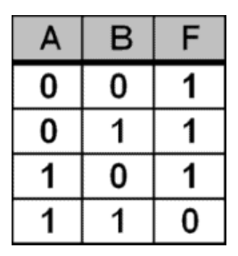
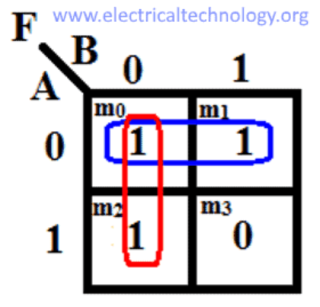
示範 F(A, B) = ∑(0,1,2)
F(A, B) = A̅B̅ +A̅B +AB̅
F(A, B) = A̅ + B̅
F(A, B) = ∑(0,1,2)
影片：https://www.youtube.com/playlist?list=PLuit3g1xQ3gJHvZWxLC8B5TEiIyISK84S

Slide 10
課堂練習

Slide 11
實驗一 : Quartus操作練習
請完成下列邏輯表示並將以下檔案壓縮並上傳:
專案
Word 檔(電路設計截圖﹑模擬波形截圖)
作業：F(A, B, C, D) = C’+A’D’+BD’
加分：Y(A, B, C, D) = ∑(0,1,2,3,4,6,8,9,10,11,14)
設計最簡電路圖

Slide 12
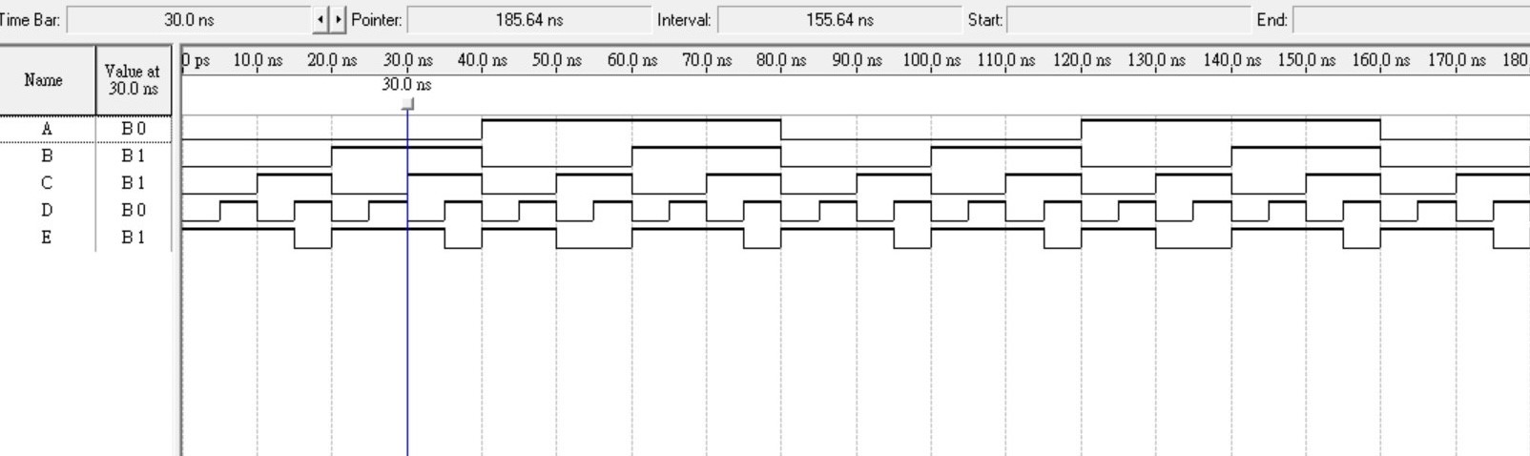
實驗一 : Quartus操作練習
作業：F(A, B, C, D) = C’+A’D’+BD’

Slide 13
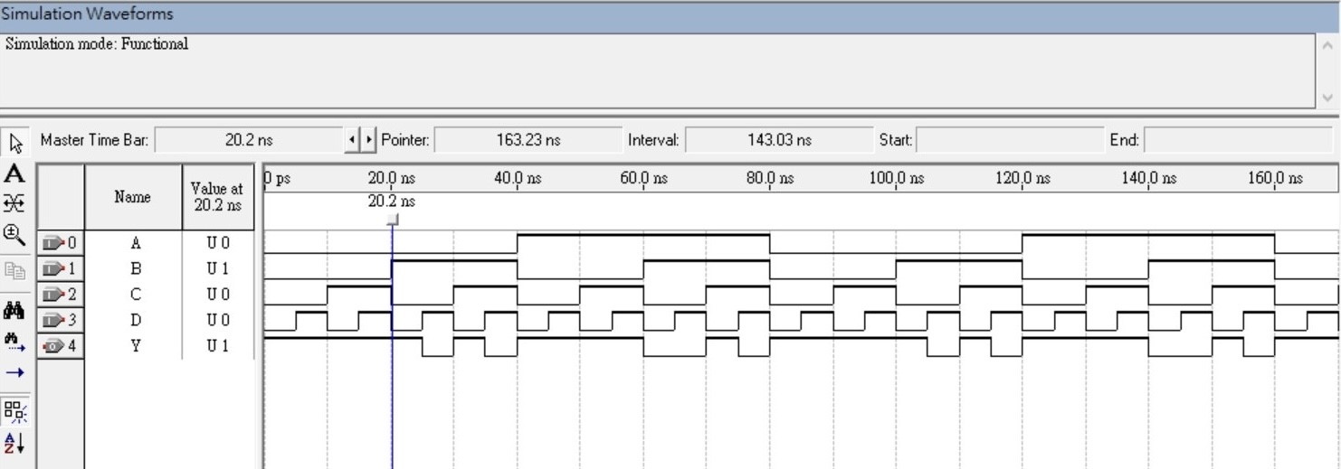
實驗一 : Quartus操作練習
加分：Y(A, B, C, D) = ∑(0,1,2,3,4,6,8,9,10,11,14)

